Slide 1


Stany Devdas
20-Jan-2024

Slide 2
Executive Summary
Introduction
Methodology
Results
Conclusion
Appendix
Outline

Slide 3
Executive Summary
Summary of methodologies
Data Collection: Utilized APIs and Web Scraping for comprehensive data acquisition.
Data Wrangling: Cleaned and transformed raw data to ensure its suitability for analysis.
Exploratory Data Analysis: Conducted in-depth analysis using SQL and visualization techniques.
Visualization and Interaction: Developed interactive maps using Folium and created dashboards using Plotly Dash for dynamic data exploration.
Machine Learning Predictions: Implemented machine learning models for classification tasks.
Summary of all results
Exploratory Data Analysis helped us achieve an enhanced understanding of parameter relationships.
Visualizations, improved comprehension of parameter effects.
Machine Learning, established an efficient predictive model with a minimum accuracy of 83%.

Slide 4
Project background and context
Collaborating with SpaceY to analyze publicly accessible data from SpaceX, focusing on the performance of Falcon 9 stage 1 rockets. Understanding the success and failure of landing these rockets is crucial as they significantly impact launch expenses. The ability to reuse them has the potential to alter the competitive landscape in the rocket launch industry.
Problems to find answers
Identify the factors, circumstances and parameters that influence the successful landing of stage 1 rockets after each deployment.
Forecast the outcome (success or failure) of a new rocket landing based on the collected parameters.
Evaluate the accuracy of the predictions made using the aforementioned parameters.
Introduction

Slide 5

Section 1

Slide 6
Methodology
Executive Summary
Data collection methodology:
Data collection involved leveraging SpaceX's public APIs and implementing web scraping techniques.
Perform data wrangling
The data underwent one-hot encoding to enhance its suitability for utilization in learning algorithms.
Perform exploratory data analysis (EDA) using visualization and SQL
Uncover novel data patterns through the application of SQL and visualization techniques.
Perform interactive visual analytics using Folium and Plotly Dash
Interactive methods in this analysis involved the utilization of Plotly Dash for dashboards and Folium maps.
Perform predictive analysis using classification models
Various machine learning algorithms were assessed to determine the most effective method.

Slide 7

Data Collection
Collecting Data using SpaceX API calls
Normalize Data using JSON functions
Preprocess columns and rows
Filter for Falcon 9 data
Loading Dictionary and converting to DataFrame Object
Using SpaceX API calls
Data Wrangling & Extract data to CSV format
Response from Webpage
Create BeautifulSoup Object
Create dictionary object
Convert to DataFrame object
Find Relevant Tables & Columns
Using Web Scrapping

Slide 8
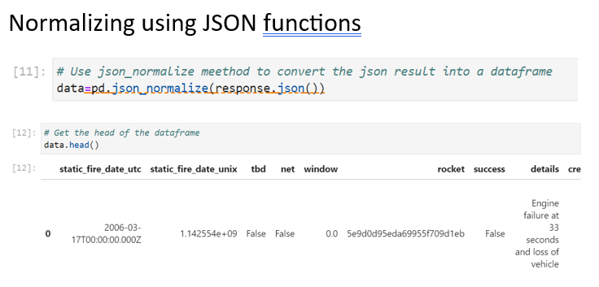
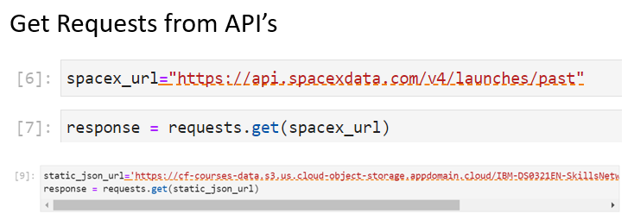
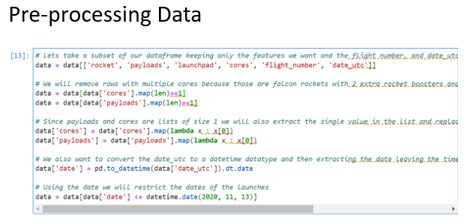
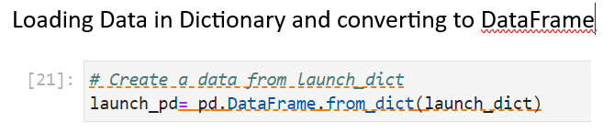
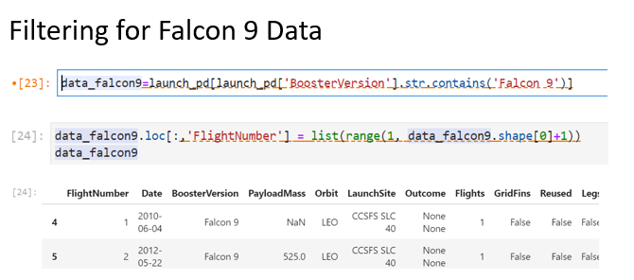
Data Collection – SpaceX API
Github Link: https://github.com/StanyDevdas/IBM_DS_CapstoneProjectSpaceX_StanyDevdas/blob/1d477a8b34a0632d6ed96f19d80479a96f0fc1fe/SpaceX_DataCollection_API.ipynb

Slide 9
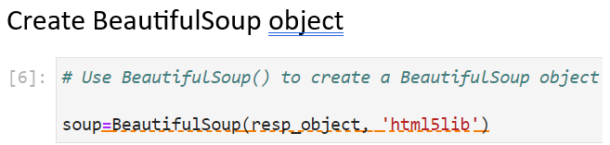
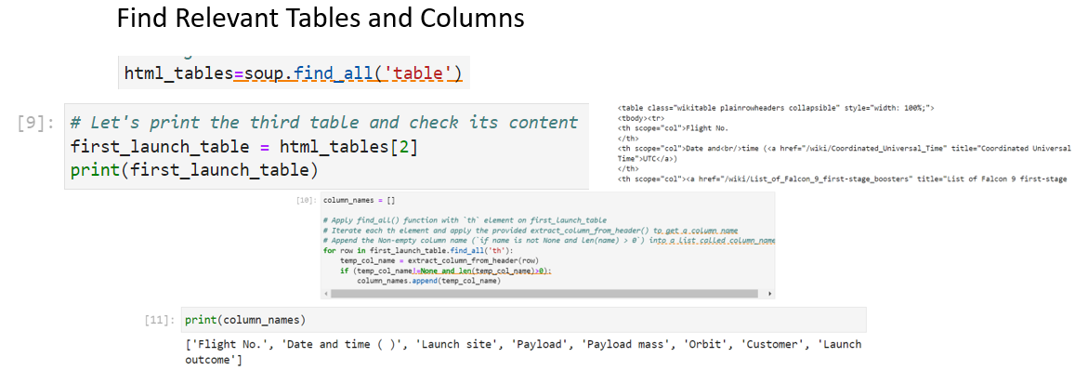
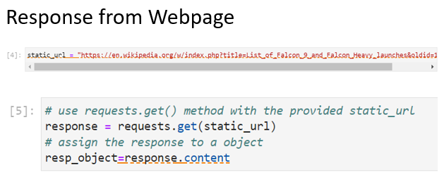
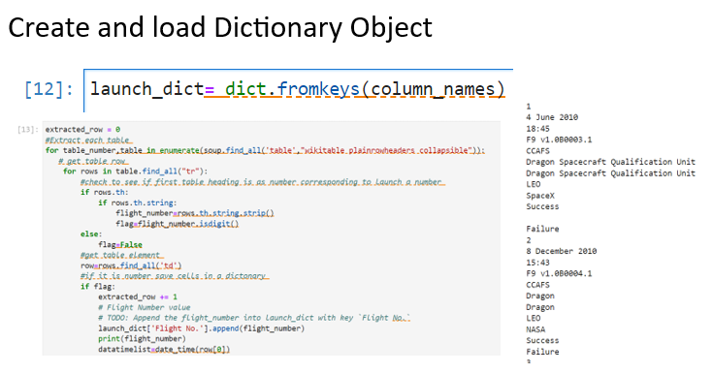
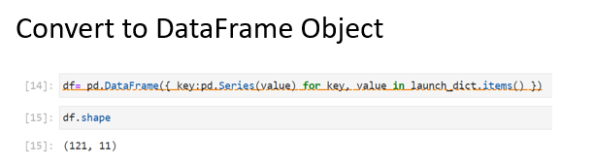
Data Collection –
Scraping
GitHub Link:
https://github.com/StanyDevdas/IBM_DS_CapstoneProjectSpaceX_StanyDevdas/blob/1d477a8b34a0632d6ed96f19d80479a96f0fc1fe/SpaceX_DataCollection_Scrapping.ipynb

Slide 10
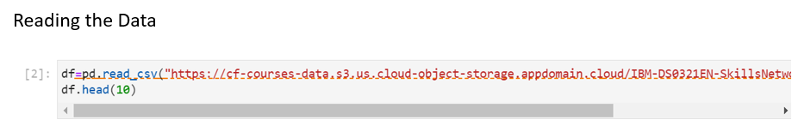
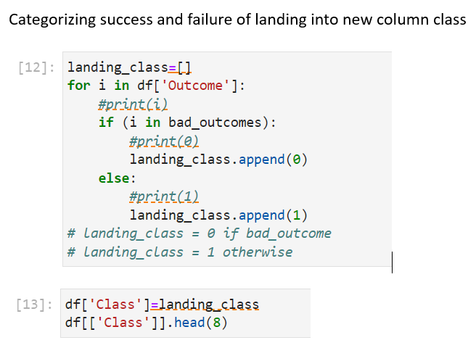
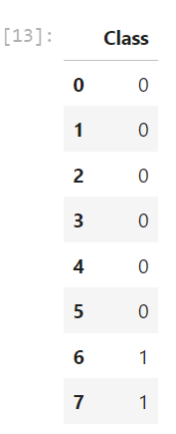
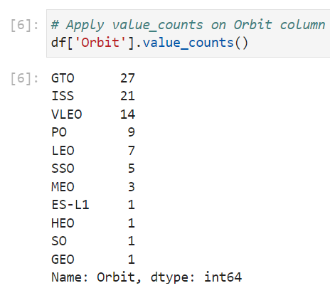
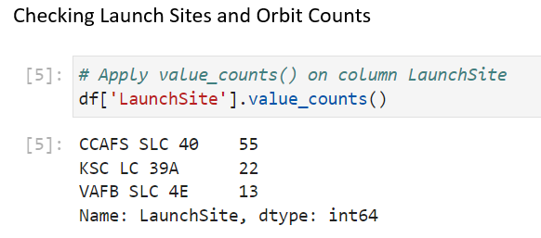
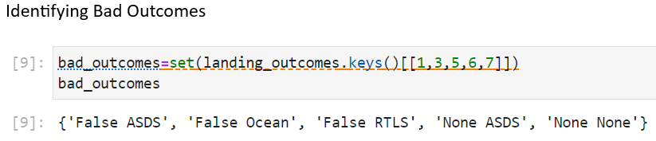
Data Wrangling
GitHub Link:
https://github.com/StanyDevdas/IBM_DS_CapstoneProjectSpaceX_StanyDevdas/blob/1d477a8b34a0632d6ed96f19d80479a96f0fc1fe/SpaceX_DataWrangling.ipynb

Slide 11
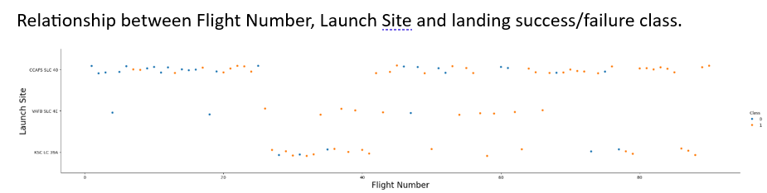
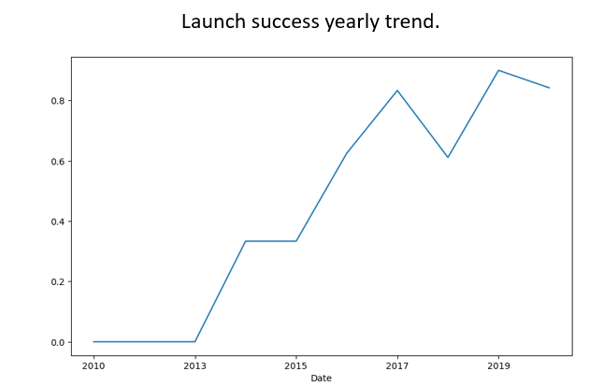
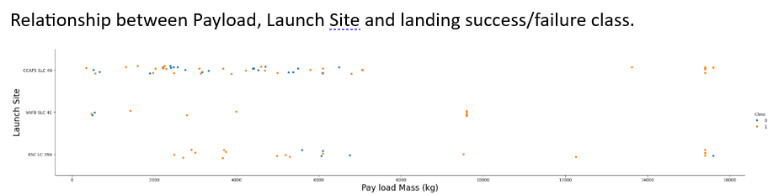
EDA with Data Visualization
Part 1

Slide 12
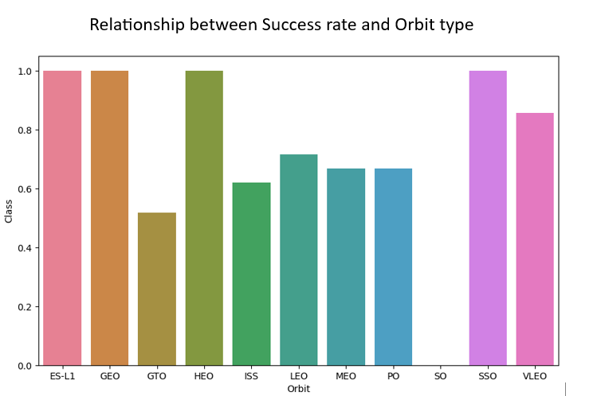
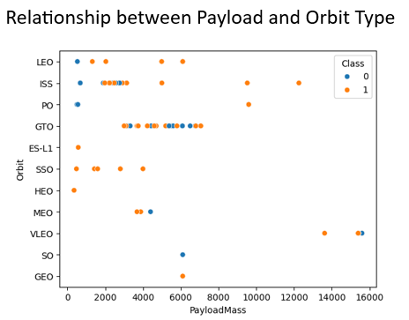
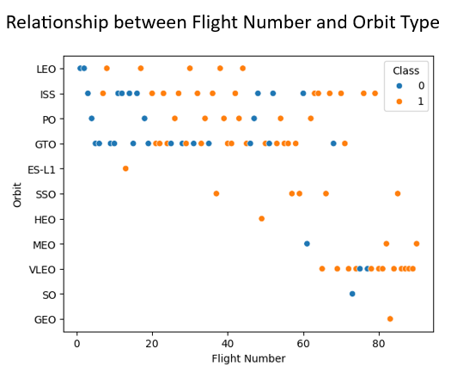
EDA with Data Visualization
Part 2
GitHub Link:
https://github.com/StanyDevdas/IBM_DS_CapstoneProjectSpaceX_StanyDevdas/blob/1d477a8b34a0632d6ed96f19d80479a96f0fc1fe/SpaceX_EDA_Visualizations.ipynb

Slide 13

Used SQL queries for the following tasks
Display the names of the unique launch sites in the space mission
Display the total payload mass carried by boosters launched by NASA (CRS)
Display average payload mass carried by booster version F9 v1.1
List the date when the first successful landing outcome in ground pad was achieved.
List the names of the boosters which have success in drone ship and have payload mass greater than 4000 but less than 6000
List the total number of successful and failure mission outcomes
List the names of the booster versions which have carried the maximum payload mass.
List the records which will display the month names, failure landing outcomes in drone ship ,booster versions, launch site for the months in year 2015.
Rank the count of landing outcomes (such as Failure (drone ship) or Success (ground pad)) between the date 2010-06-04 and 2017-03-20, in descending order.
EDA with SQL
GitHub Link:
https://github.com/StanyDevdas/IBM_DS_CapstoneProjectSpaceX_StanyDevdas/blob/1d477a8b34a0632d6ed96f19d80479a96f0fc1fe/SpaceX_EDA_SQLlite.ipynb

Slide 14

Marked all launch sites, and added map objects such as markers, circles, lines to mark the success or failure of launches for each site on the folium map, using folium.Circle and folium.Marker
Assigned the feature launch outcomes (failure or success) to class 0 and 1. i.e., 0 for failure, and 1 for success, using the color-labeled Marker Cluster , we identified which launch sites have relatively high success rate.
Calculated the distances between a launch site to its proximities. We answered some question for instance:
Are launch sites near railways, highways and coastlines.
Do launch sites keep certain distance away from cities.
Built an Interactive Map with Folium
GitHub Link:
https://github.com/StanyDevdas/IBM_DS_CapstoneProjectSpaceX_StanyDevdas/blob/1d477a8b34a0632d6ed96f19d80479a96f0fc1fe/SpaceX_LaunchSite_MapAnalysis.ipynb

Slide 15

Built a Dashboard with Plotly Dash
Built an interactive dashboard with Plotly Dash
Plotted pie charts showing the total successful launches by All sites or selected sites (selected from dropdown).
Plotted scatter graph showing the relationship with Outcome and Payload Mass (Kg) for the different booster version ranges (with dynamic payload range slider).
GitHub Link:
https://github.com/StanyDevdas/IBM_DS_CapstoneProjectSpaceX_StanyDevdas/blob/1d477a8b34a0632d6ed96f19d80479a96f0fc1fe/SpaceX_Dash.py

Slide 16
Predictive Analysis (Classification)
Building the model
1
Create array Y for output class
Standardize the data
Split into training and testing set
Build GridSeachCV model and fit the data
Evaluating the model
2
Calculating the accuracies
Calculating the confusion matrix
Plot the results
Finding the optimal model
3
Find the best hyperparameters for the model
Find the best model with highest accuracy on testing data
Confirm the optimal model
GitHub Link:
https://github.com/StanyDevdas/IBM_DS_CapstoneProjectSpaceX_StanyDevdas/blob/1d477a8b34a0632d6ed96f19d80479a96f0fc1fe/SpaceX_Machine_Learning_Prediction.ipynb

Slide 17
Results
The SVM, KNN and Logistic regression models are the best in terms of prediction accuracy
Low weighted payloads perform better than the heavier payloads
The success rates of SpaceX launches have significantly improved over the years
KSC LC 39A had the most successful launches from all the sites
Orbits GEO, HEO, SSO, ES L1 have the best success rates

Slide 18

Section 2

Slide 19
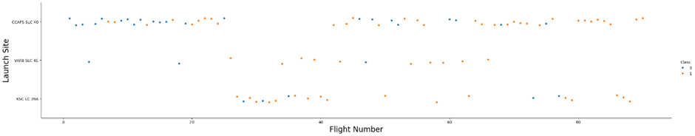
Flight Number vs. Launch Site
Launches from the site of CCAFS SLC 40 are significantly higher than launches from other sites
With the increase in flight number, the success rates also increases

Slide 20
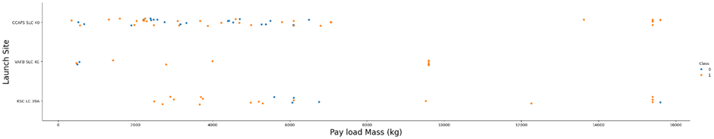
Payload vs. Launch Site
Majority of Pay loads with lower Mass range have been launched from CCAFS SLC 40

Slide 21
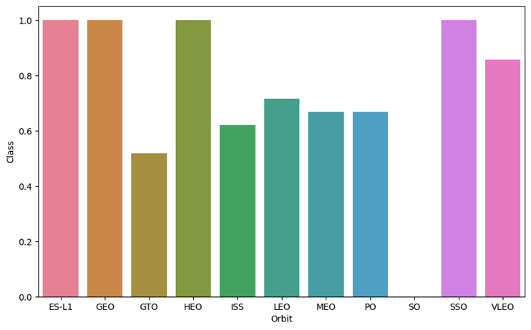
Success Rate vs. Orbit Type
Following orbits have high success rate (100%)
ES-L1
GEO
HEO
SSO
SO has the least success (0%)

Slide 22
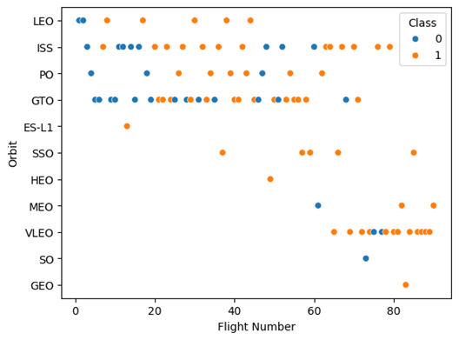
Flight Number vs. Orbit Type
A trend can be observed where the latest launches have been shifted to VLEO orbit with good success rates

Slide 23
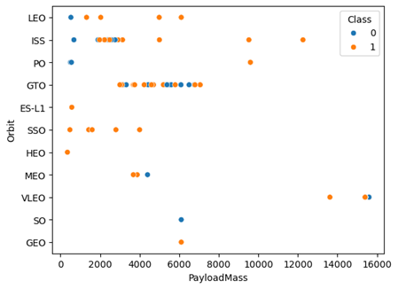
Payload vs. Orbit Type
Co-relation between ISS orbit and payloads between range of 2000 and 4000 kgs.
Also a relationship between the GTO orbit and payload range of 3000-7000 kgs.

Slide 24
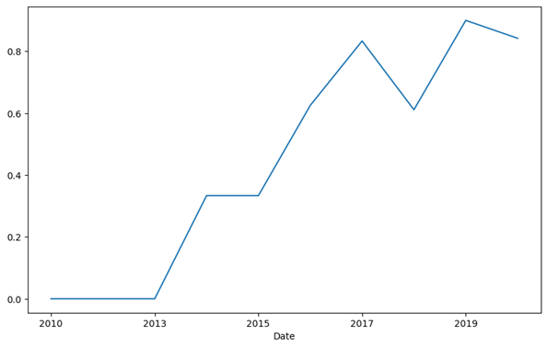
Launch Success Yearly Trend
Success rates are significantly increasing over the years, even with the dip and failures around 2018

Slide 25
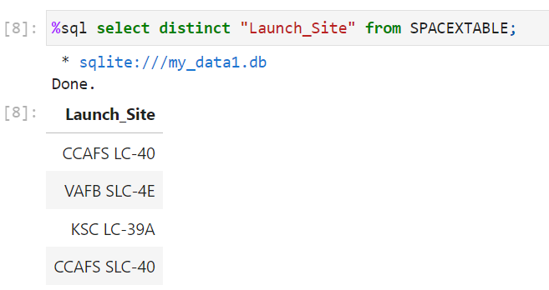
All Launch Site Names
Using DISTINCT keyword for listing unique names
25

Slide 26
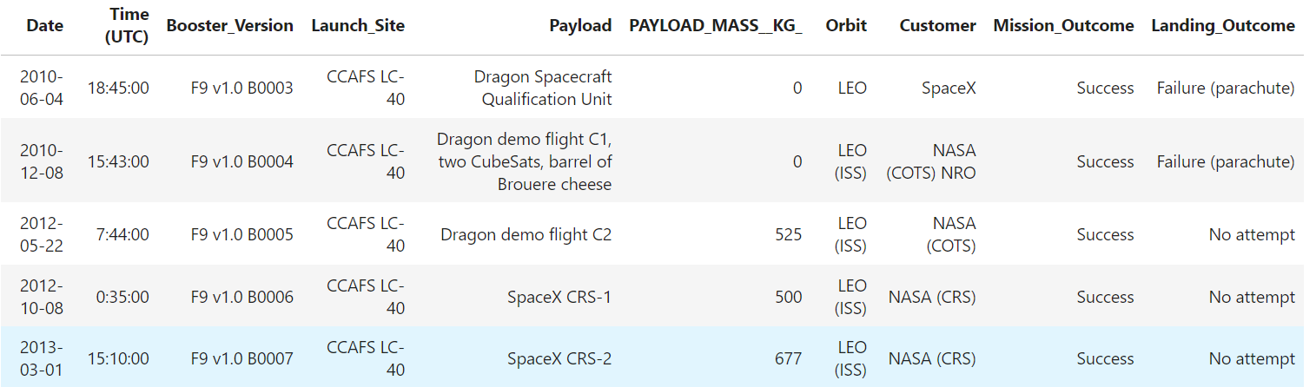
Launch Site Names Begin with 'CCA'
Used keyword LIMIT to display only 5 records
26

Slide 27
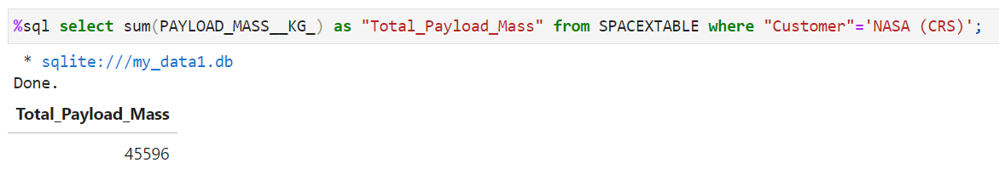
Total Payload Mass
Used the keyword SUM.
27

Slide 28
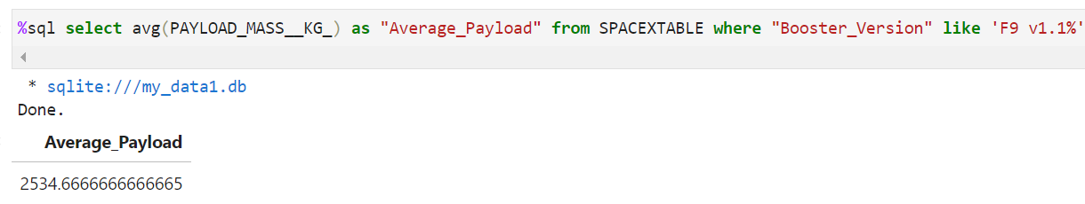
Average Payload Mass by F9 v1.1
Used the keyword AVG
28

Slide 29
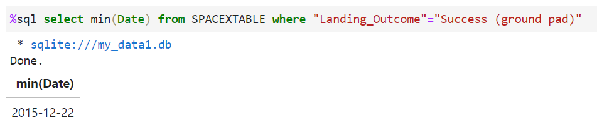
First Successful Ground Landing Date
Used the keyword MIN on the date column with the appropriate condition to find the required parameter
29

Slide 30
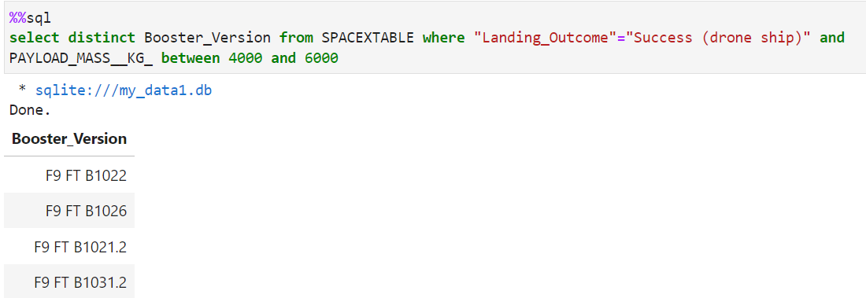
Successful Drone Ship Landing with Payload between 4000 and 6000
Displaying list the names of boosters which have successfully landed on drone ship and had payload mass in between 4000 and 6000
30

Slide 31
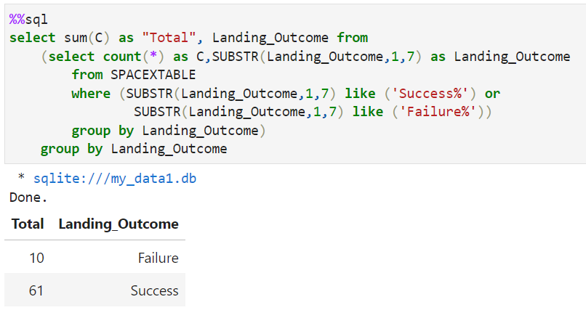
Total Number of Successful and Failure Mission Outcomes
Used the query with GROUP BY feature
Results show 10 Failures and 61 Successful landing
31

Slide 32
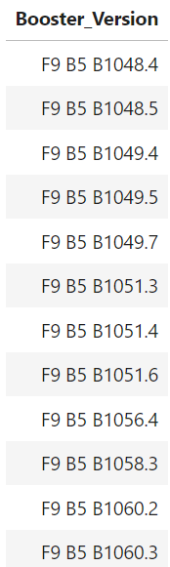
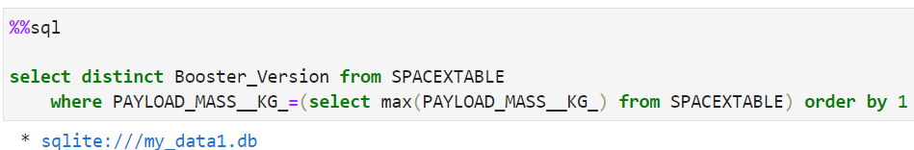
Boosters Carried Maximum Payload
Using Sub-query to get the distinct list of booster version meeting the payload conditions
32

Slide 33
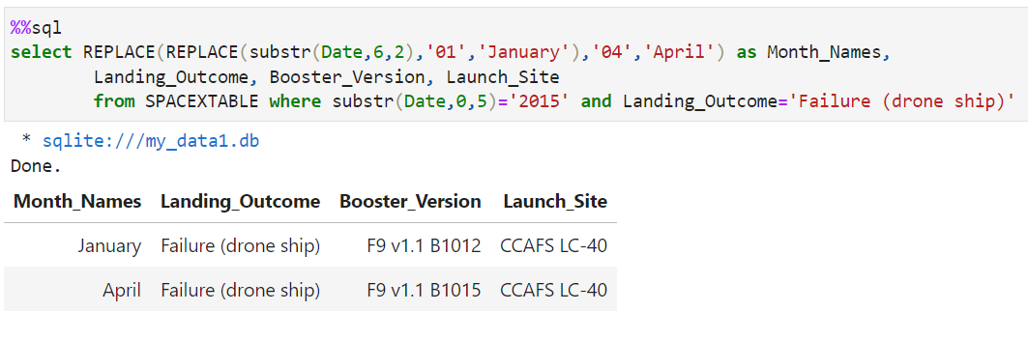
2015 Launch Records
Matched the 2015 records using SUBSTR function in the where conditions
33

Slide 34
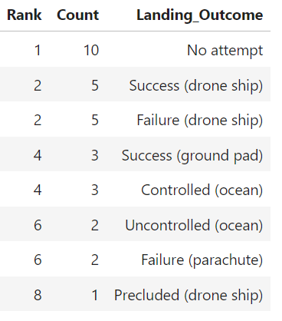
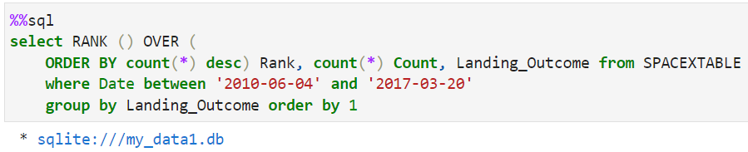
Rank Landing Outcomes Between 2010-06-04 and 2017-03-20
Using the RANK function on the descending order of count function used to count number of landing outcomes in the given date range.
34

Slide 35

Section 3

Slide 36
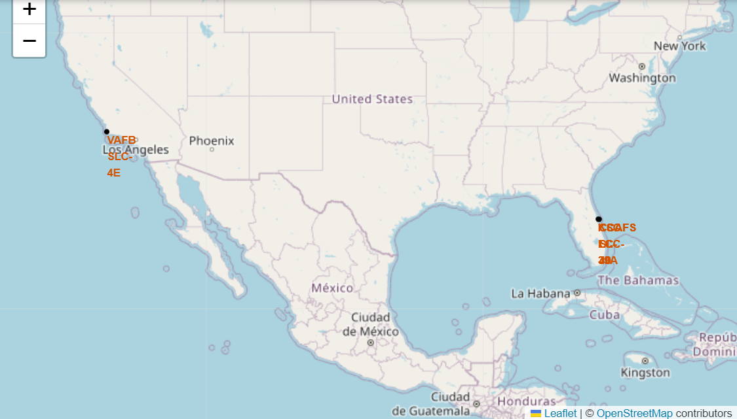
Launch Sites for SpaceX
All SpaceX rockets are launched from the coastal lines of Florida and California in the United States of America

Slide 37
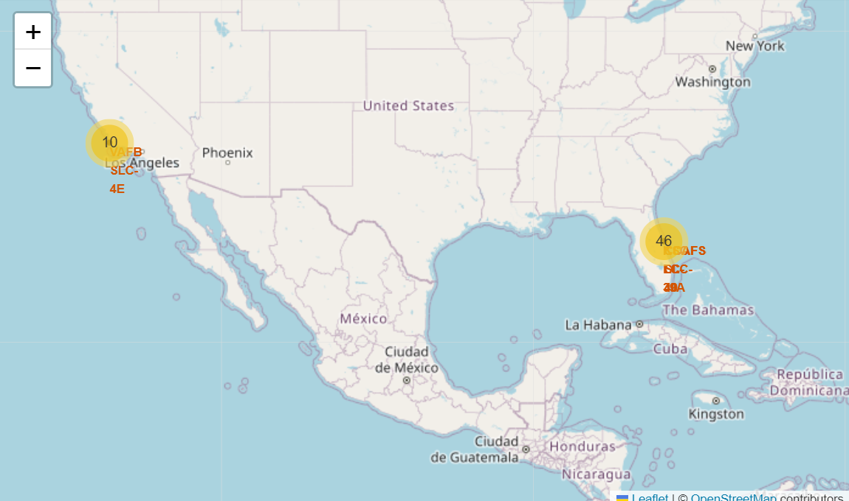
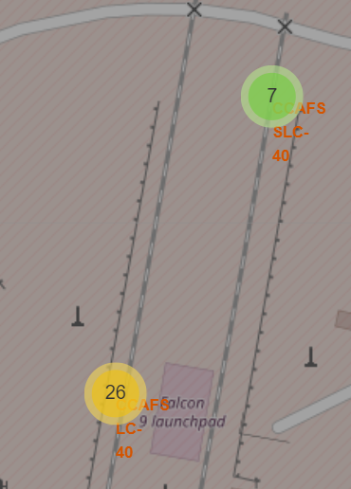
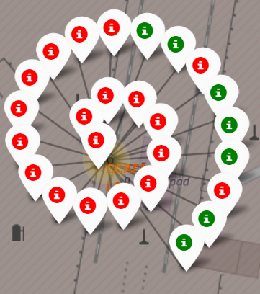
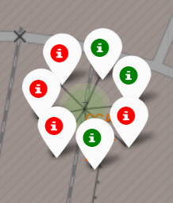
Markers showing launch sites with color labels
Green label show successful launch

Slide 38
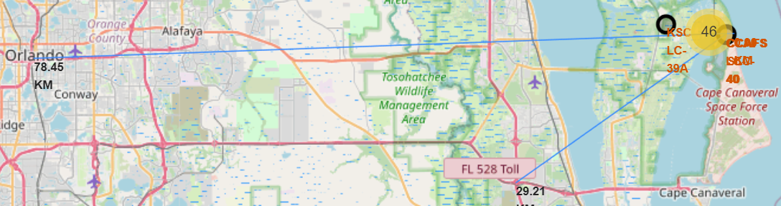
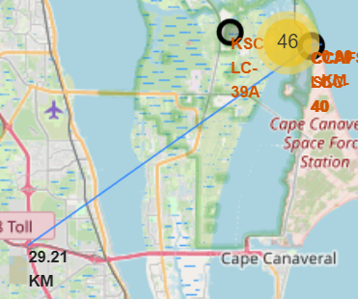
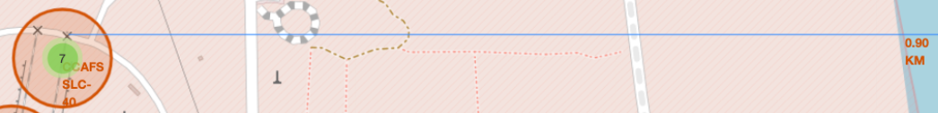
Distances between a launch sites to its proximities
All infrastructures like, railway line, highway, coastal line and nearest city are in close proximities

Slide 39

Section 4

Slide 40
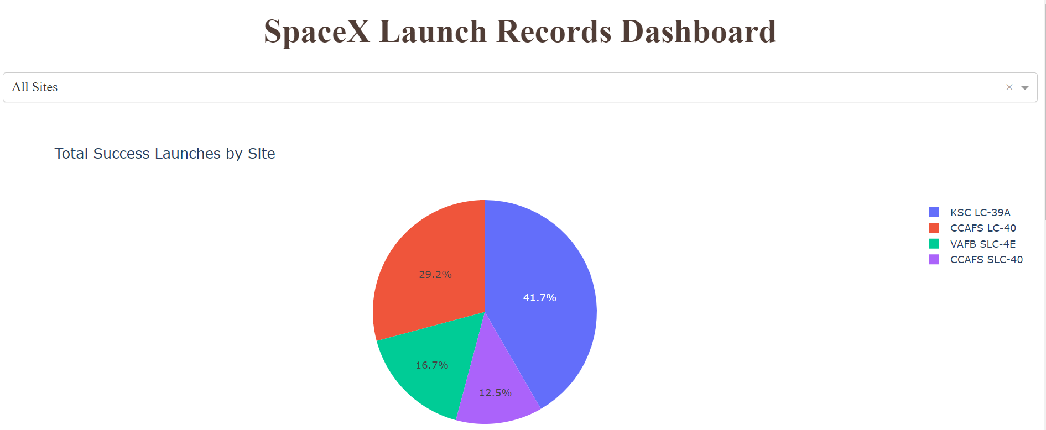
Total success Launches by all sites
KSC LC-39A has had the most successful launches in comparison to all the launch sites.

Slide 41
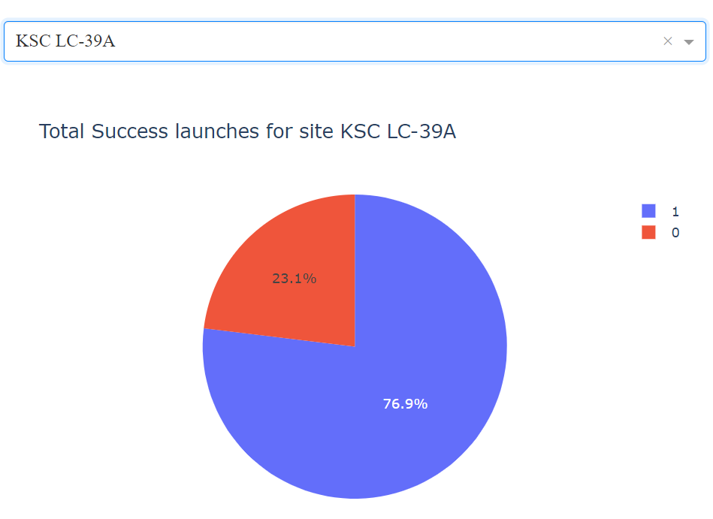
Success Rate by Site (KSC LC-39A)
KSC LC-39A has a 76.9% success rate as a launch site

Slide 42


Success rates on variable payload using Dash Rangeslider
Payload (0-5000kg) range for all sites
Payload (5000-10000kg) range for all sites

Slide 43

Section 5

Slide 44

Classification Accuracy
As seen in screenshot, all algorithms have similar accuracy
We select K-Nearest Neighbours as the preferred algorithm
44

Slide 45

Confusion
Matrix
Of KNN Model
Matrix shows that inaccuracies in the model result in displaying False negatives, but never result in False positives
45

Slide 46
In summary:
The launch success rate exhibited a consistent increase from 2013 to 2020.
Lighter payloads demonstrated higher success rates compared to heavier payloads.
Orbits such as ES-L1, GEO, HEO, SSO, and VLEO achieved the highest success rates.
KSC LC-39A emerged as the site with the highest number of successful launches.
The K-Nearest Neighbor algorithm proved to be the most effective for this specific task.
Conclusions

Slide 47


